Slide 1
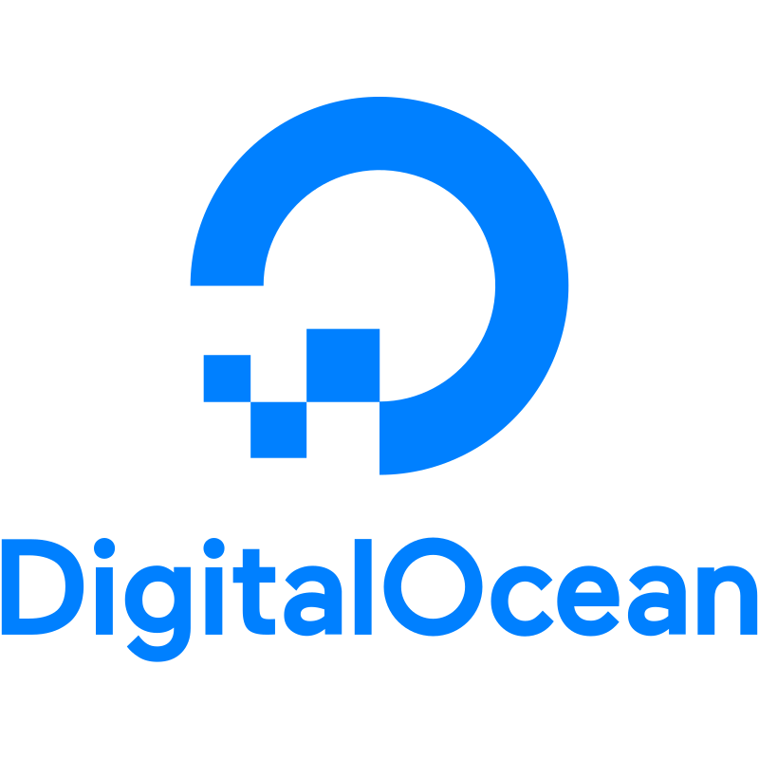

DigitalOcean Kubernetes Web App Deployment Guide
Sai Hari Krishnan
Technical Account Manager
17th June 2025

Slide 2
Agenda
Prerequisites for deploying the App on DigitalOcean Cloud
High-Level Architecture for the setup
Clone / Create App & Dockerize it and test locally
Push Local Image to Docker Hub
Creating Kubernetes Cluster (DOKS) on DigitalOcean
Configuring kubectl to Use DOKS [DigitalOcean Clusters]
Creating Kubernetes YAML (Config) files, Deploy & Test it
Cost Optimization Tips & High Availability Suggestions

Slide 3

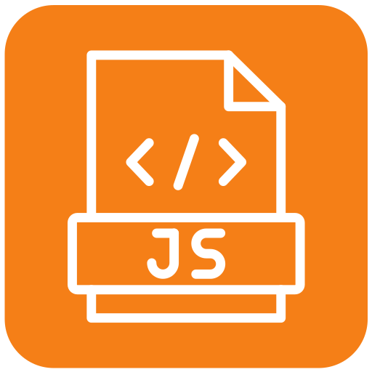
Prerequisites for deploying App on DigitalOcean Cloud
Git & GitHub: Clone / Create a new app
Docker: To host the dockerized App
Kubectl: To Manage the Digital Ocean K8s Clusters via Command line.
NodeJs: Javascript Runtime to run apps.
DigitalOcean Account with Credits

Slide 4
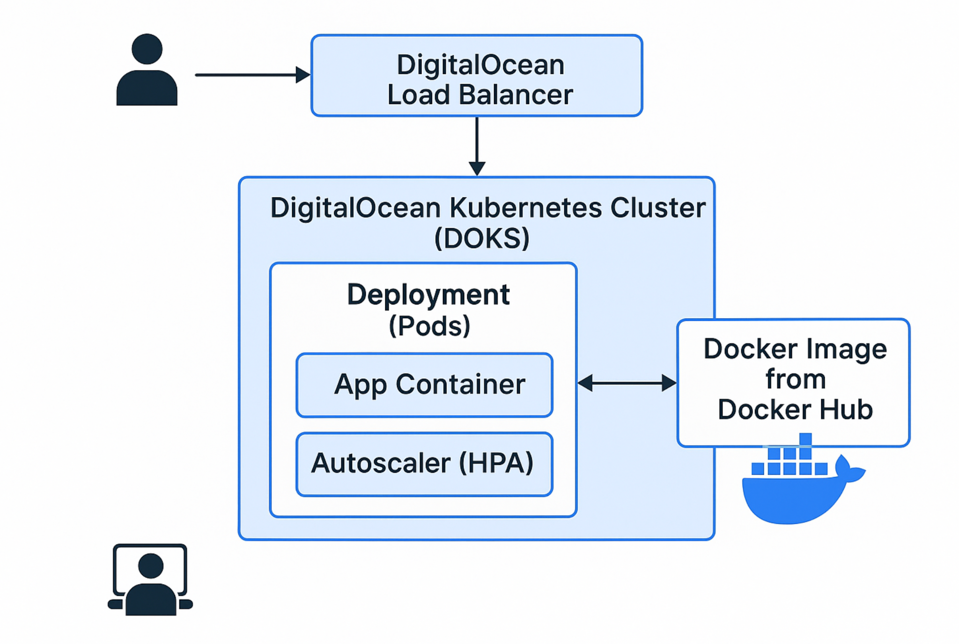
High-Level Architecture for the setup
Notes:
1 Node Deployed There a HPA Autoscaler secvies also enabled

Slide 5
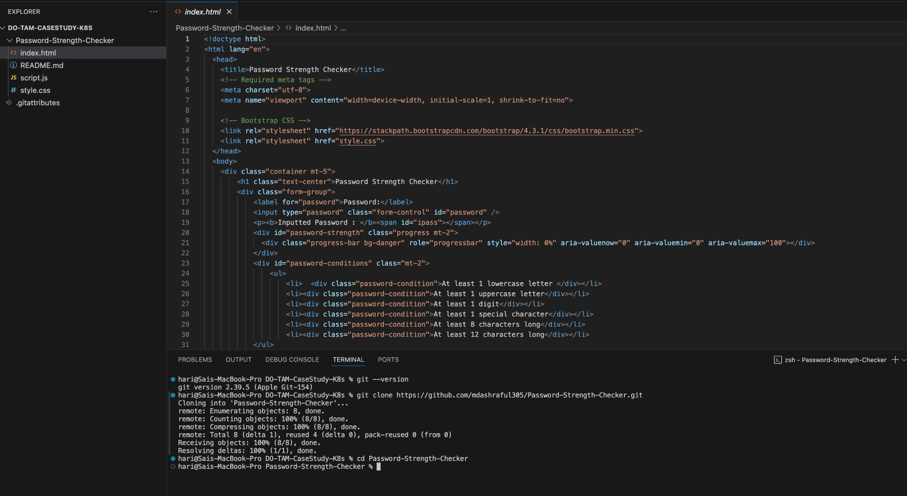
Clone Password Strength Checker App from GitHub
Step 1 - Cloning App
Step 2 - Go into App Folder
Notes:
Git clone https://github.com/mdashraful305/Password-Strength-Checker
Todo: Annotate the image with step numbers.

Slide 6
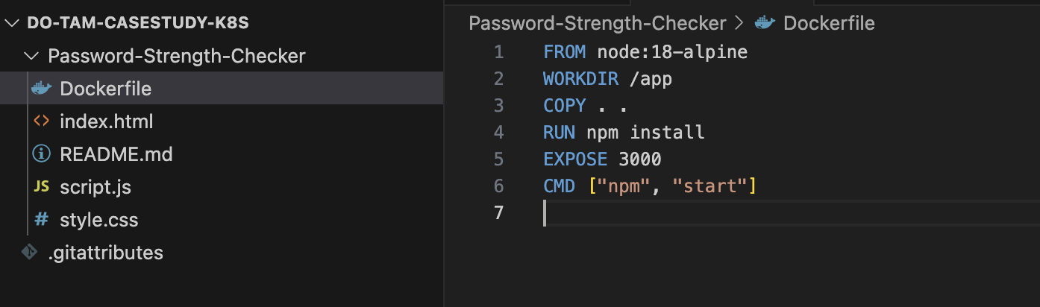
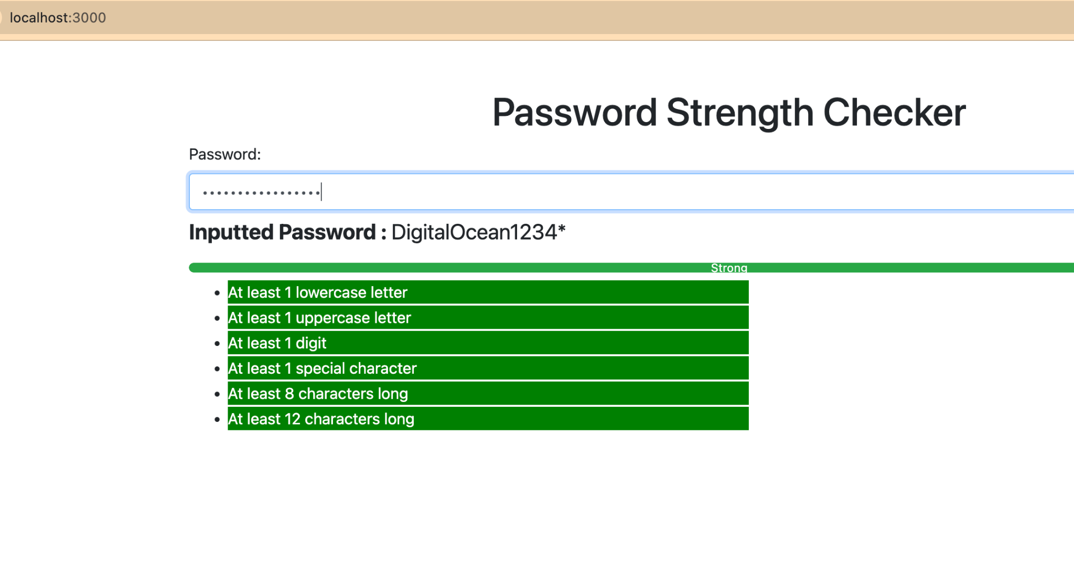
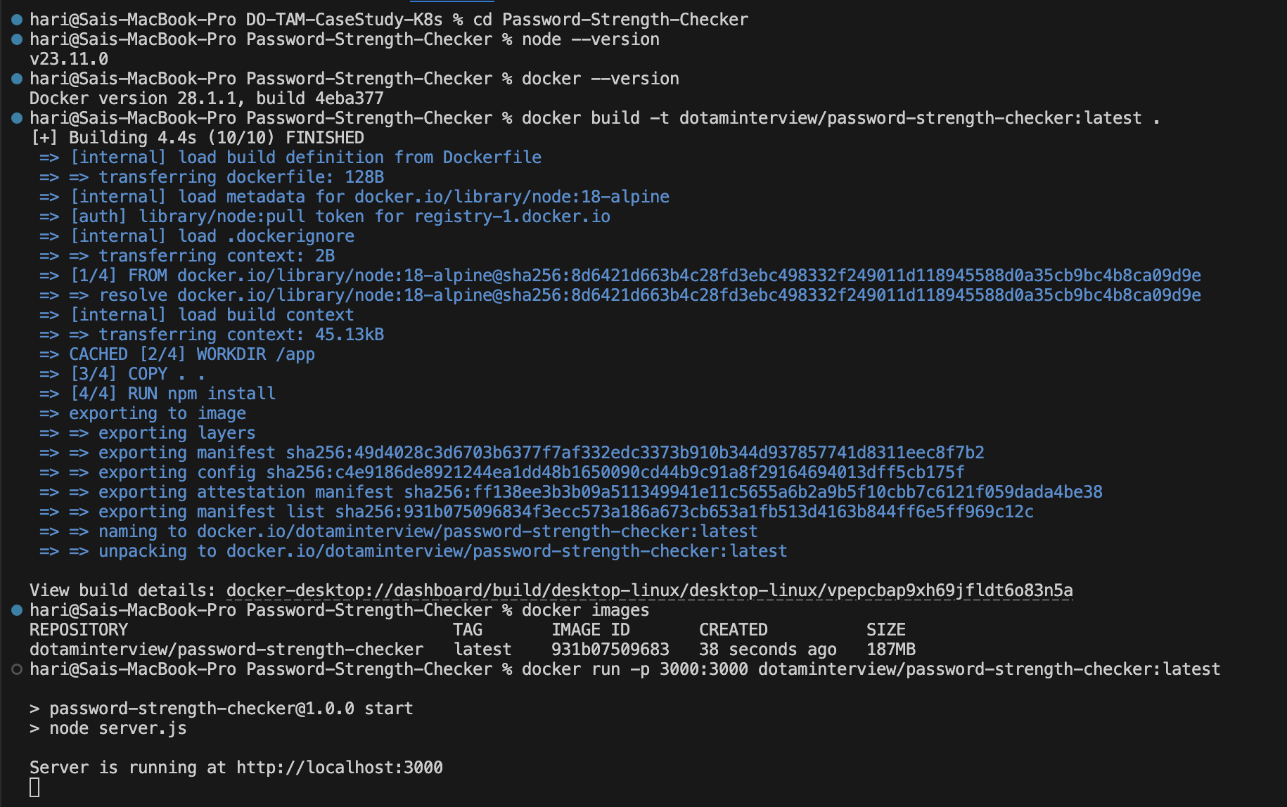
Dockerize the App and test it locally.
Step 3 - Creating Docker File
Step 4 - Building Docker Image
Step 5 - Running the docker image (App) locally
Notes:
Then build, tag, and test the image locally:
docker build -t dotaminterview/password-strength-checker:latest . docker run -p 3000:3000 dotaminterview/password-strength-checker:latest

Slide 7
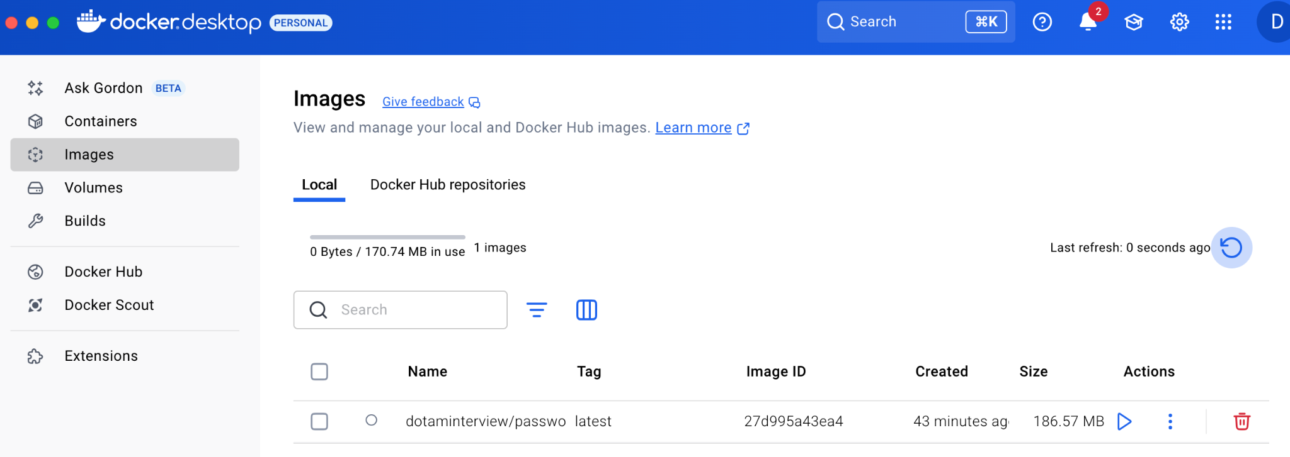
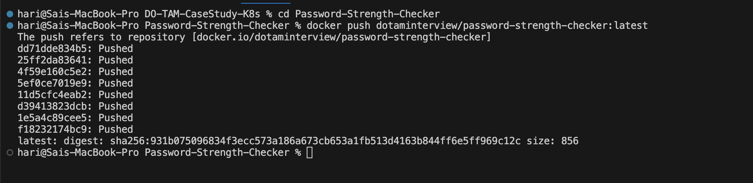
Push Local Image to Docker Hub
Step 6 - Pushing Image to Docker hub
Notes:
Pushing the docker image to Docker Hub
docker push dotaminterview/password-strength-checker:latest

Slide 8
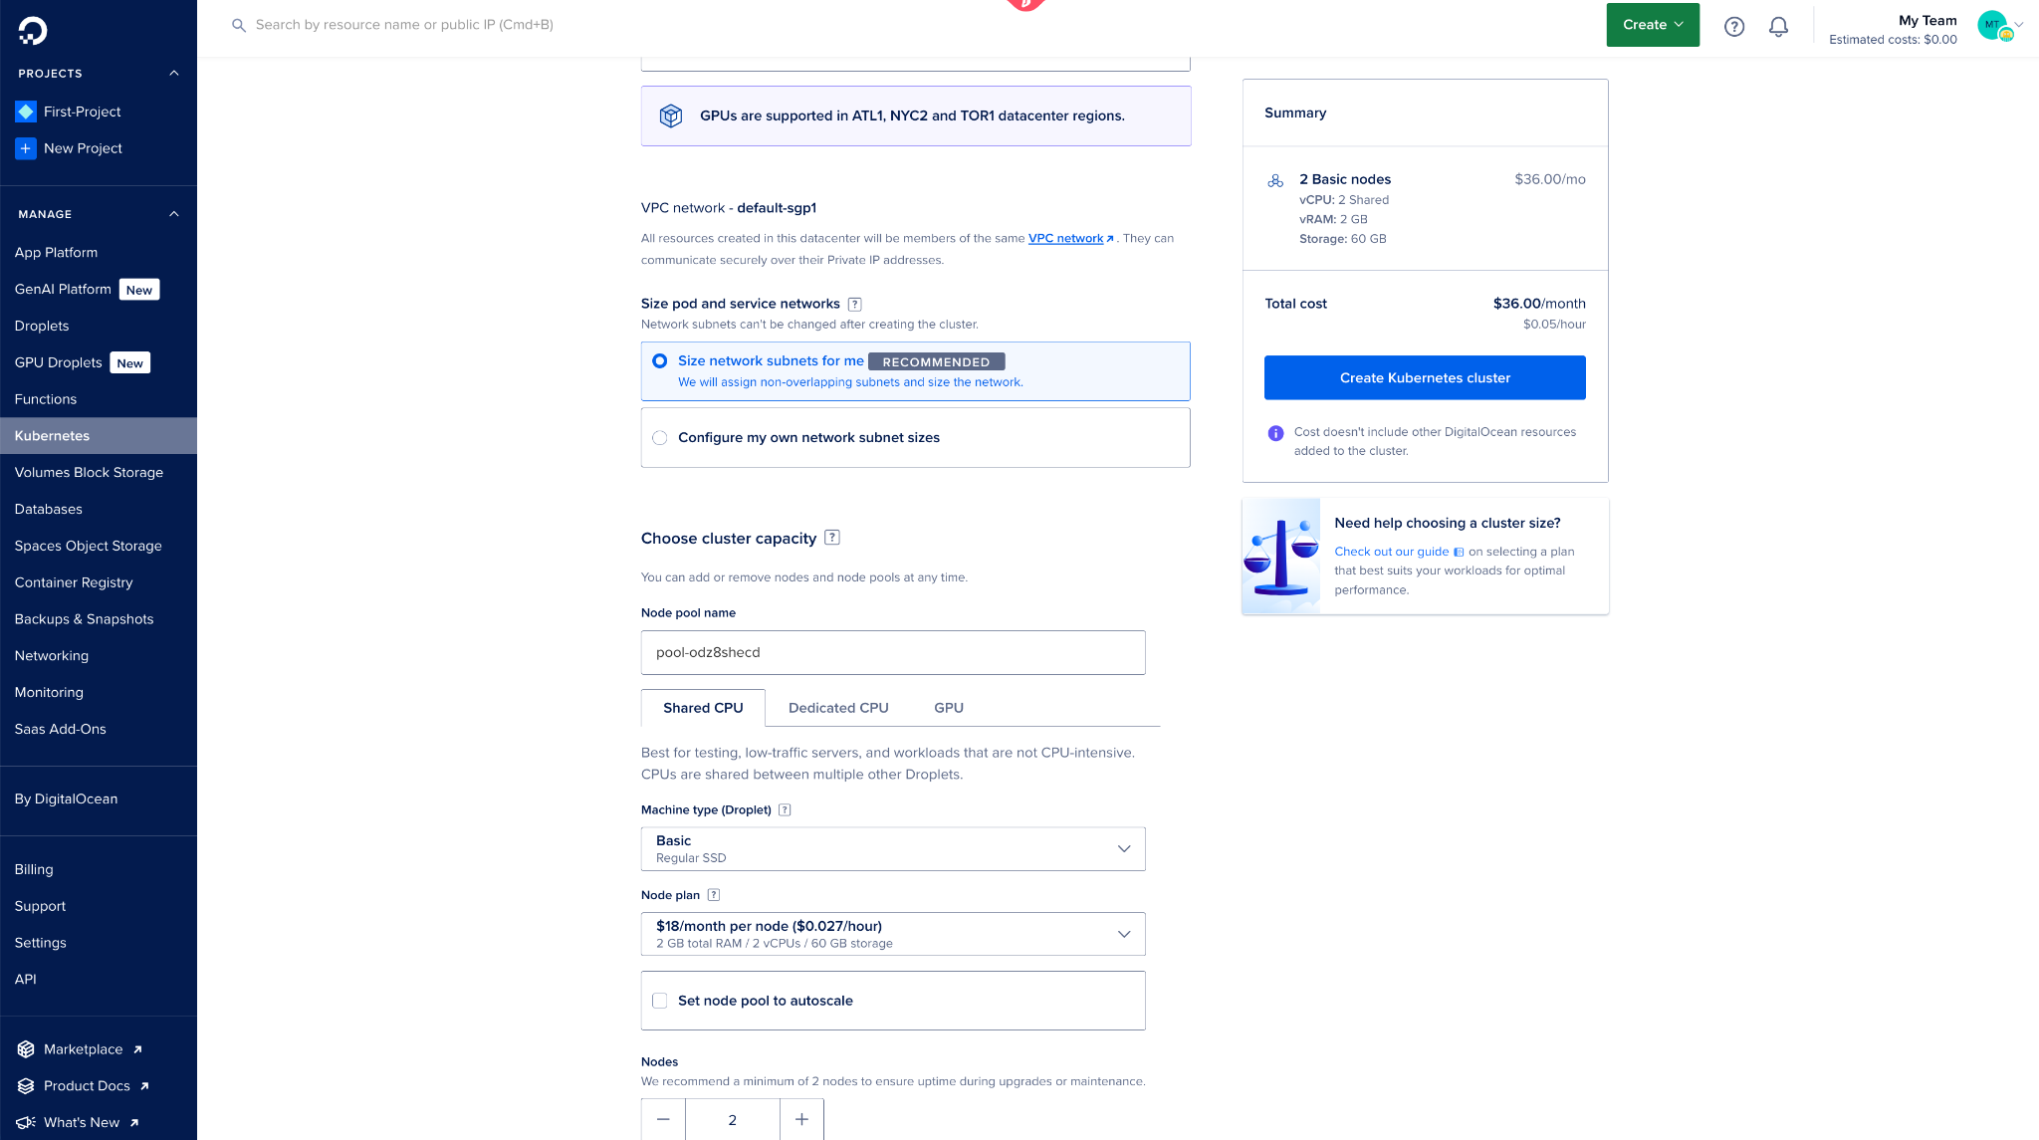
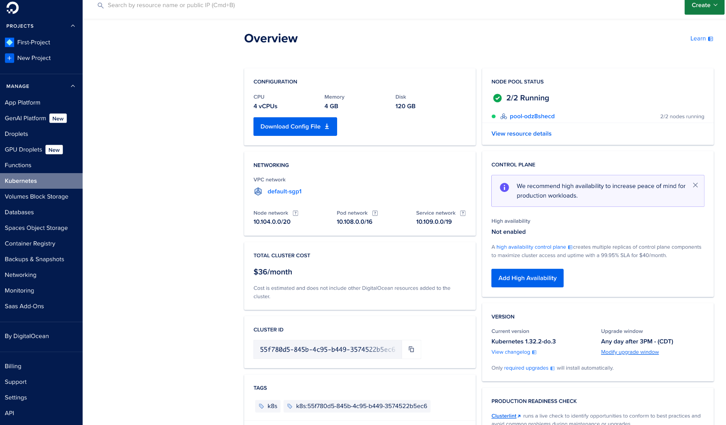
Creating Kubernetes Cluster (DOKS) on Digital Ocean
Step 7 - Creating DOKS Clusters
Step 8 - Download Cluster Config File

Slide 9
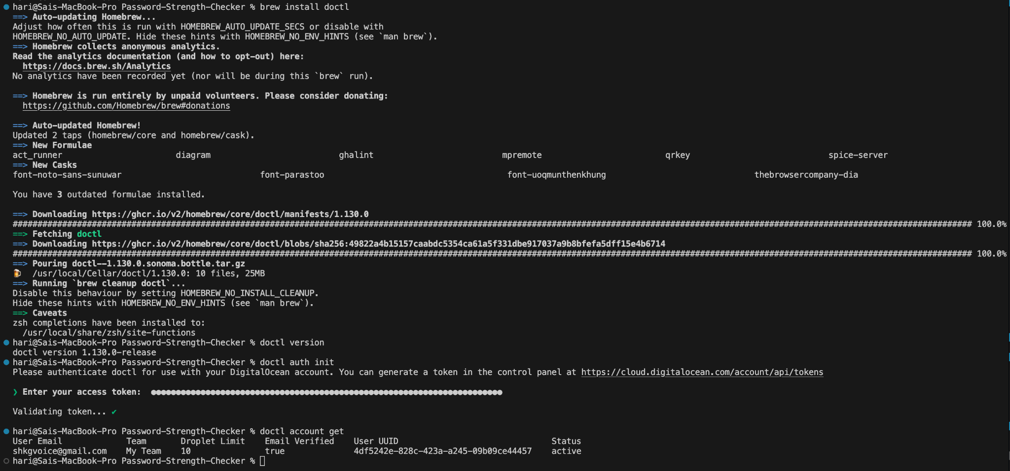
Recommended: Configuring doctl to Authenticate to Digital Ocean

Slide 10
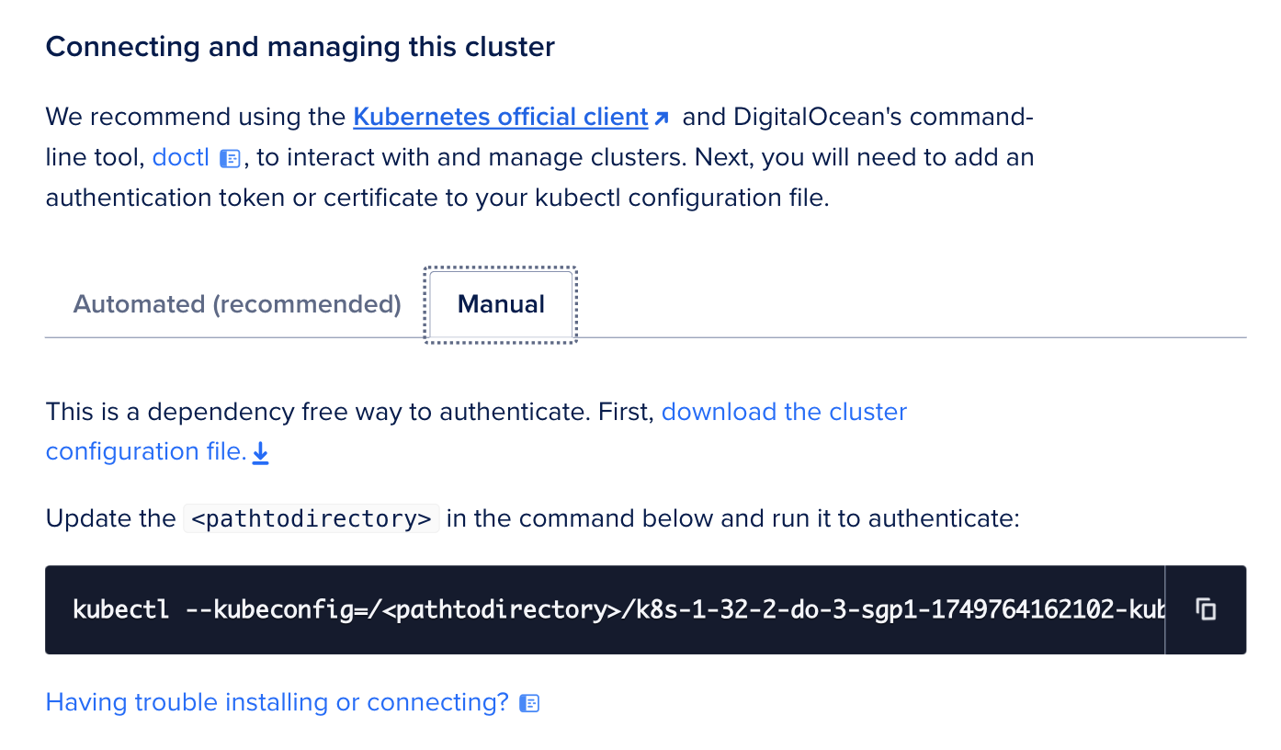
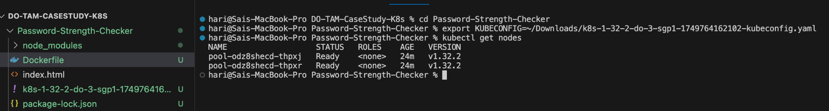
Configuring kubectl to Use DOKS [DigitalOcean Clusters]
Step 9 - Connecting to DOKS Clusters via CLI
Notes:
Manual - Kubectl : This command explicitly points to a kubeconfig file to fetch and verify the status of nodes within our Kubernetes cluster. It's particularly helpful for managing infrastructure in automation scripts, CI/CD jobs, or multi-cluster scenarios, ensuring operations are targeted at the correct environment without relying on global defaults. Kubectl - Kubernetes CLI: interacts directly with a Kubernetes cluster What it does:
Reads the kubeconfig (generated by doctl) to know how to reach the cluster.
Authenticates using the token/cert in the kubeconfig.
Executes commands: list nodes, deploy apps, check logs, etc. Think of kubectl as the remote control to operate your cluster.
While kubectl is the primary tool for interacting with a Kubernetes cluster, it depends on a valid kubeconfig file for authentication and connectivity. In a managed Kubernetes environment like DigitalOcean’s, doctl serves a critical function: it securely retrieves and refreshes this kubeconfig. Without it, kubectl cannot connect to the cluster — making doctl essential for initial setup and continued access.
Automatic [Recommended] We use doctl kubernetes cluster kubeconfig save to automatically refresh our kubeconfig with secure, time-limited credentials issued by DigitalOcean. This helps avoid authentication errors due to expired tokens and ensures our access to the cluster remains both secure and up-to-date, particularly important for ongoing cluster management, CI/CD automation, or platform support. Doctl - DigitalOcean's CLI: manages DigitalOcean services, including Kubernetes
What it does:
Retrieves your cluster’s kubeconfig file from DigitalOcean.
Updates your local machine’s ~/.kube/config or a custom file.
Handles authentication using your DigitalOcean API token.
Automatically refreshes expiring credentials (which are short-lived in DOKS).
Think of doctl as the gateway to fetch and manage cluster access.
doctl provides secure and programmatic access to fetch Kubernetes credentials from DigitalOcean. It automates authentication and ensures short-lived tokens are updated. kubectl then uses those credentials to communicate directly with the Kubernetes API server — allowing us to perform cluster operations confidently and securely.

Slide 11
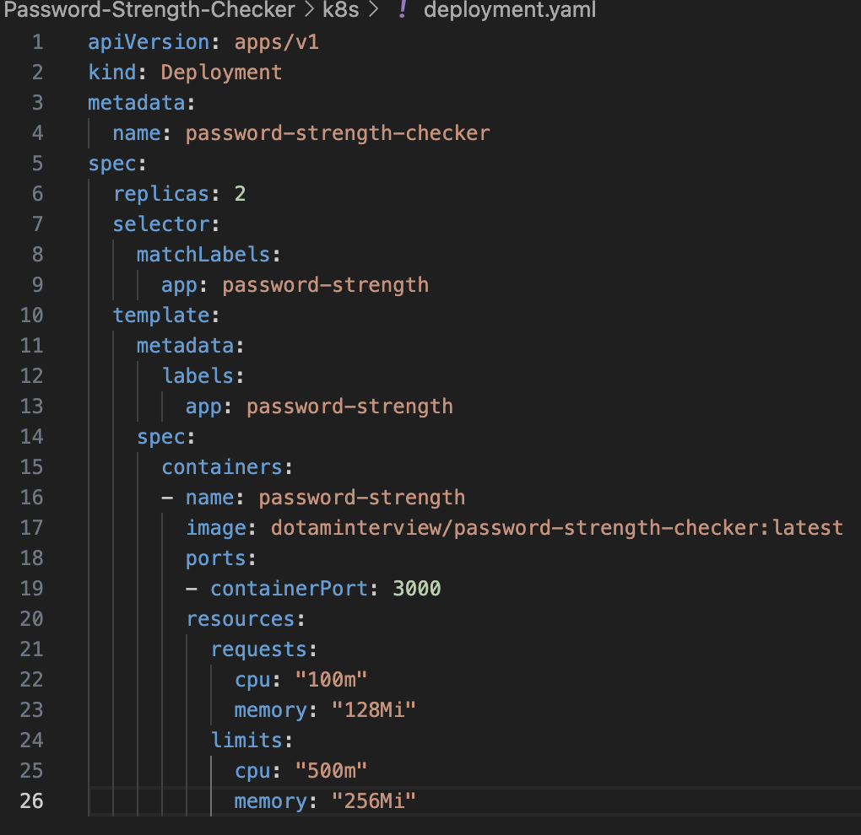
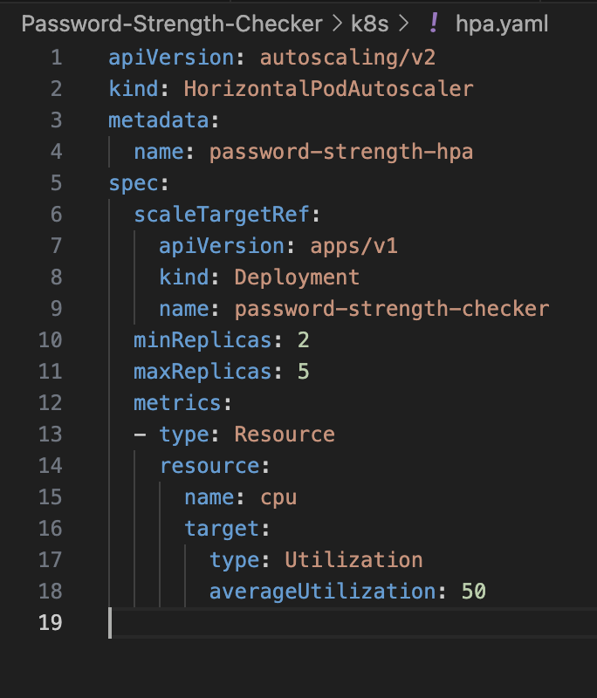
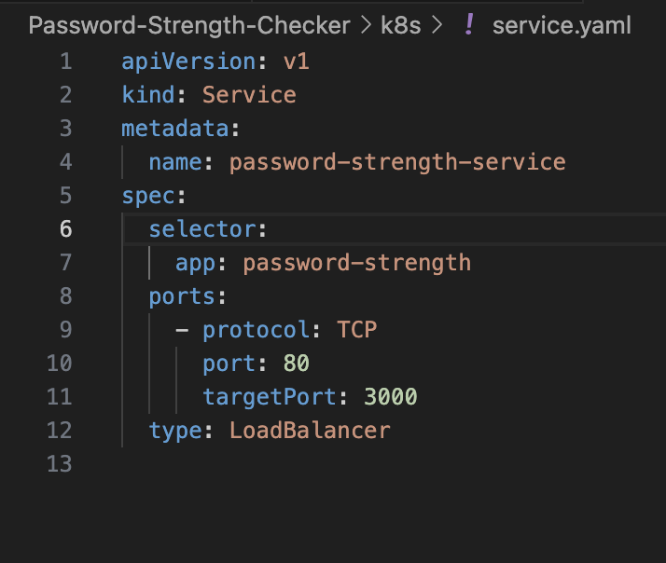
Creating Kubernetes YAML (Config) files
service.yaml
deployment.yaml
hpa.yaml
Step 10 - Creating YAML Config Files
Notes:
Write Kubernetes YAML Files
Why? YAML files define how your app should run in the cluster. Think of them like blueprints.
deployment.yaml: Defines how many app instances (pods) should run and what container image to use.
service.yaml: Exposes your app on the internet using a LoadBalancer.
hpa.yaml: Adds Horizontal Pod Autoscaling so your app grows/shrinks automatically based on CPU usage.
These definitions let Kubernetes manage everything for you — high availability, scaling, restarts, etc.

Slide 12
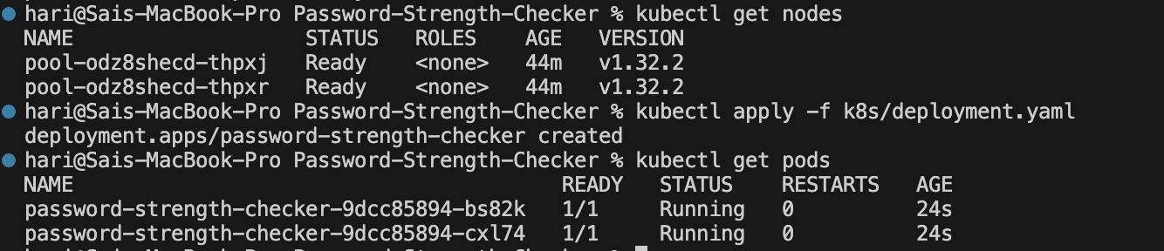
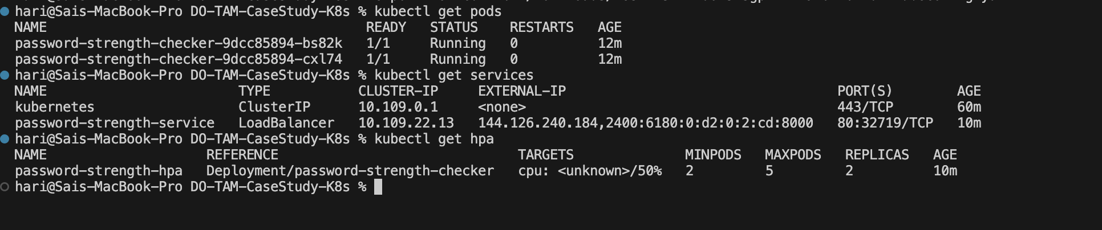
Deploying the YAML files to DOKS Clusters & Verify Setup
deployment.yaml
service.yaml
hpa.yaml
Verifying Setup
Step 11 - Deploying YAML Config Files & verifying it

Slide 13
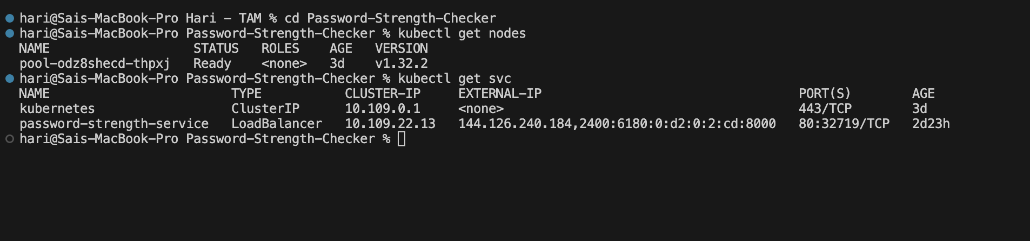
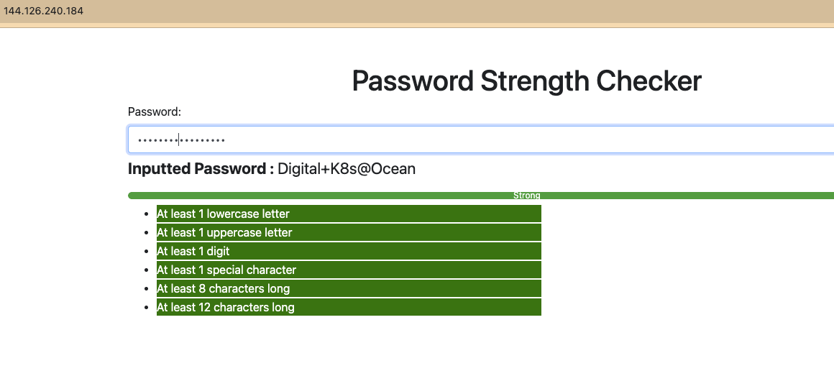
Accessing the Deployed App on DigitalOcean Cluster
Step 12 - Accessing the Deployed App via external IP on Browser

Slide 14
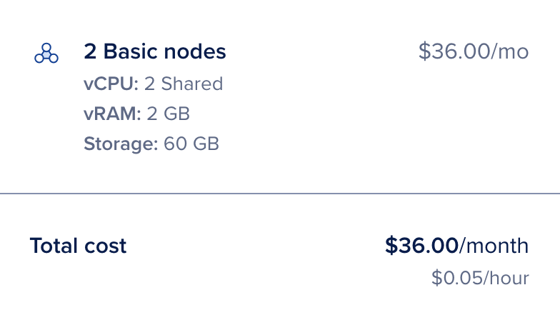
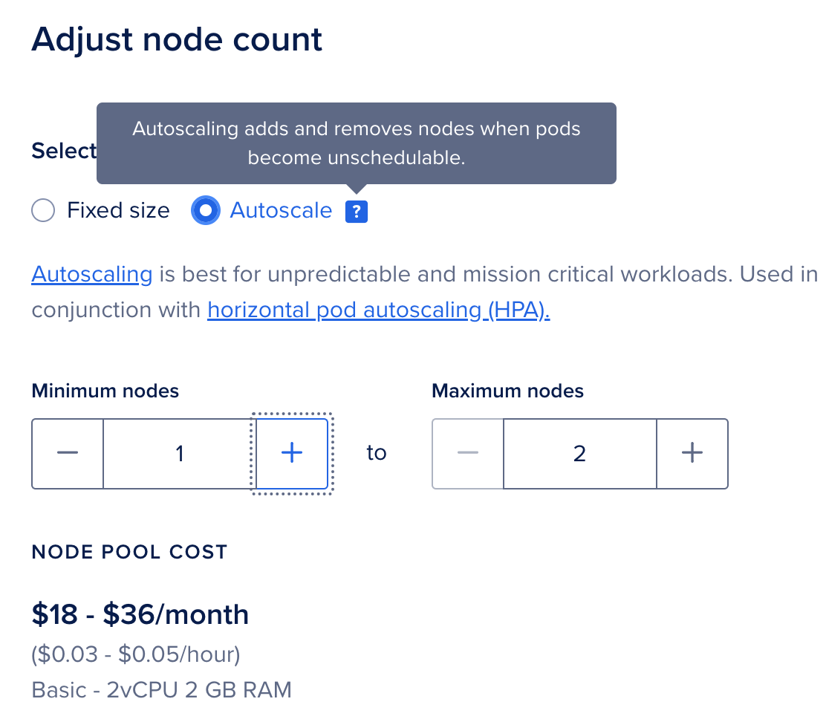
Cost Optimization Tips & Suggestions
Turn on Node Autoscaling in the DO Dashboard
Run Multiple Low-Traffic Apps on the Same Node
Downgrade to s-1vcpu-1gb Nodes if Usage is Low
Use DigitalOcean Monitoring to Right-Size
Manually Delete Unused Load Balancers & Volumes
Notes:
Turn on Node Autoscaling in the DO Dashboard For your existing node pool, enable autoscaling to let the cluster add or remove nodes based on real traffic — for example, scale down from 2 nodes to 1 at night to cut costs by 50%.
Run Multiple Low-Traffic Apps on the Same Node If you have apps like internal tools, dev environments, or low-traffic microservices, run them on a single node to avoid paying for extra infrastructure you don’t need.
Downgrade to s-1vcpu-1gb Nodes if Usage is Low If your pods never exceed ~100m CPU or 300Mi memory, switch from s-2vcpu-2gb ($24/month) to s-1vcpu-1gb ($12/month) and cut node cost in half.
Use DigitalOcean Monitoring to Right-Size Visit the DO Dashboard → Kubernetes → Metrics tab to see actual CPU & RAM usage. If you're consistently under 30% usage, consider scaling down.
Manually Delete Unused LoadBalancers & Volumes Check the Networking → Load Balancers and Volumes tab in the DO dashboard. Each idle resource can add $10–$12/month — remove any not tied to active services.

Slide 15
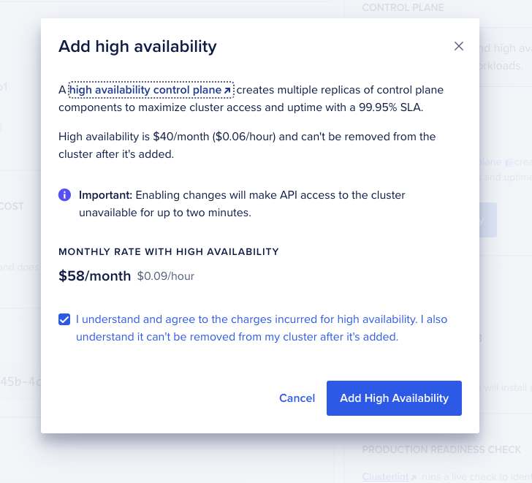
High Availability for 99.95% Uptime SLAs
DigitalOcean Kubernetes provides a high availability (HA) option that increases the reliability of the control plane by creating multiple backup replicas of each control plane component.

Slide 16
Thank You & Questions

